Slide 1
RefreshEd
Review/22

Slide 2
RefreshEd - Inceptions
… gather information, contextualize it within our means, environment, and culture, and develop a plan to refresh the technology fabric across the district. […] a solid foundation of infrastructure, responsive and adaptable to change. Coupled to the foundation is a platform of devices, services, and support – equitable and ubiquitous across all schools, programs and needs…

Slide 3
RefreshEd - Vision
TECHNOLOGY
- Infrastructure is built with change and adaptation in mind
- A strong platform of devices is available and equitably across the system
Lifetime and support is a driving force for planning
PERCEPTION AND CULTURE
- Trust exists in the system that their endeavors will be supported by the technology fabric (Foundation, Platform, Systems and Support)
- People feel supported and heard

Slide 4
Foundation (Servers, Wiring, Infrastructure)
Platform (Devices)
Apps/Websites
Professional Learning
Educational Technology
Ed Tech Working Group
Scaffolding (Digital Literacy, Coding etc.)

Slide 5
Hardware Cycles
Devices (Laptops, Desktops, iPads)
Monitors
Printers/Copiers
Access Points (Wireless)
Switches (Wired networks)
Servers (Schools and District)
Projectors
Document Cameras
Battery Backup Systems

Slide 6
Devices
Over 2300 windows devices in the district
ThinClients are now fully removed from the school district
4 new high-end video editing/3D design computer labs across our secondary schools
560 iPads with 100s cycling in every year
81 Classroom iPads
Communicating Student Learning
Differentiated instruction
Document Camera
Mobile French Teachers “Virtual Classroom”
iPad/Laptop
Itinerant and Secondary staff all on laptops with docking stations

Slide 7
Networking
Updating cabling: Lochside, Cordova Bay Elementary, and currently underway at Claremont
New CDC building and Claremont we are rolling out a full-scale evaluation of new networking gear that can:
Bring 10x – 100x improvements to local speeds
Next-gen wireless
Unified management of network-connected services
Improved network security

Slide 8
Projectors
Very dated in our system, often left to schools to procure in the past
Working with schools collectively to ramp-up District Refresh
Ordered first round of refreshed projectors June 2021, expected arrival February 2022
Developed a plan to target oldest devices in learning spaces

Slide 9
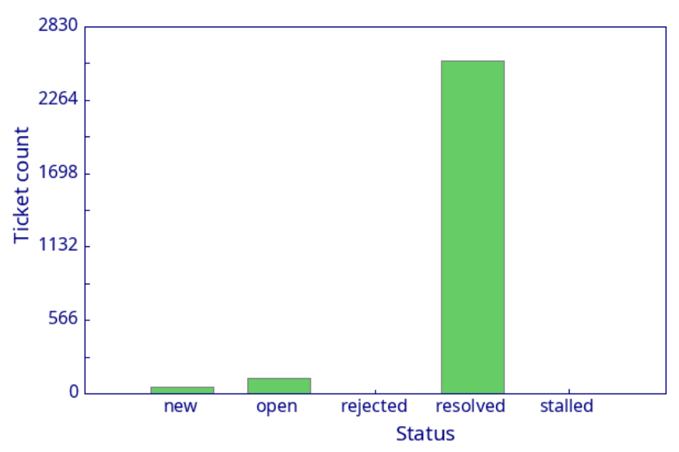
Support Team
RefreshIT project saw school-based technology support (including SIDES) join our core team at the district
Also joining the district team is an electrician (supporting cabling and technology installations) and a Student Information Systems Coordinator (primarily focused on supporting Learning Commons Technicians)
Nearly 1200 tickets closed in September – over 70 per day of instruction
From start-up to Dec 1. 2756 tickets resolved, 2746 created

Slide 10
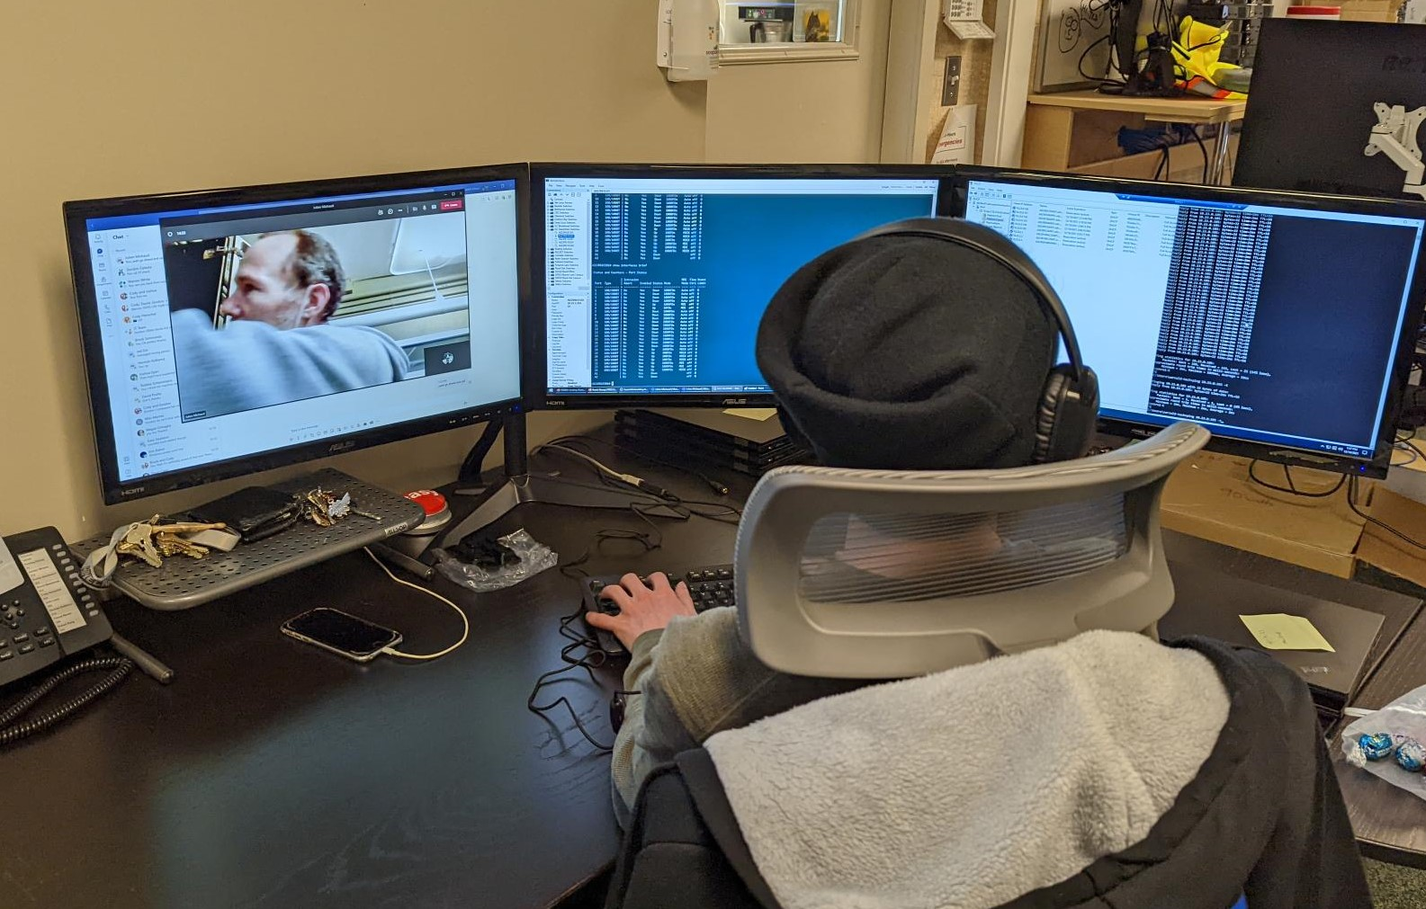
Support Team
The centralized IT support role has many new tools, and many new responsibilities for those joining us from the schools.
We have been working closely with them building new skills, benefiting from the ones they bring with them, and showing everyone new ways of solving problems.
Minor renovations in the IT shop to handle the increased numbers of people and the increased flow of technology through the doors

Slide 11
Addressing Risk
Disaster Recovery
Nearly fully virtualized
Backup and Restore process speeds increased 100x much more efficient storage
Business Continuity
Rapidly deployed devices to community and staff when COVID hit
Adapted to the remote and hybrid landscapes
Continue supporting nominal role and community students with technology
Security
Brought in systems to protect our systems, our staff and students and their information (Update schedules, Proofpoint, Varonis)

Slide 12
Privacy
Established a sub-group in the EdTech Working group to specifically address privacy
New amendments to FOIPPA will have an impact to the tools we use, and how we evaluate them
Goal of informing and building a district culture that understands the role privacy serves in supporting learners and our district tools
Embedding privacy and security evaluations as part of the framework that supports onboarding new tools and resources

Slide 13
EdTech Working Group – The Yes Machine
Trust and Equity inform all our thinking. The goal was to provide and equal-access process that is transparent to all involved for onboarding new tools and systems
Sub-group consists of Teachers, Administrators and District Staff to shepherd tools through the machine

Slide 14
EdTech Working Group – The Yes Machine

Slide 15
EdTech Working Group – The Yes Machine

Slide 16
EdTech Working Group – The Yes Machine

Slide 17
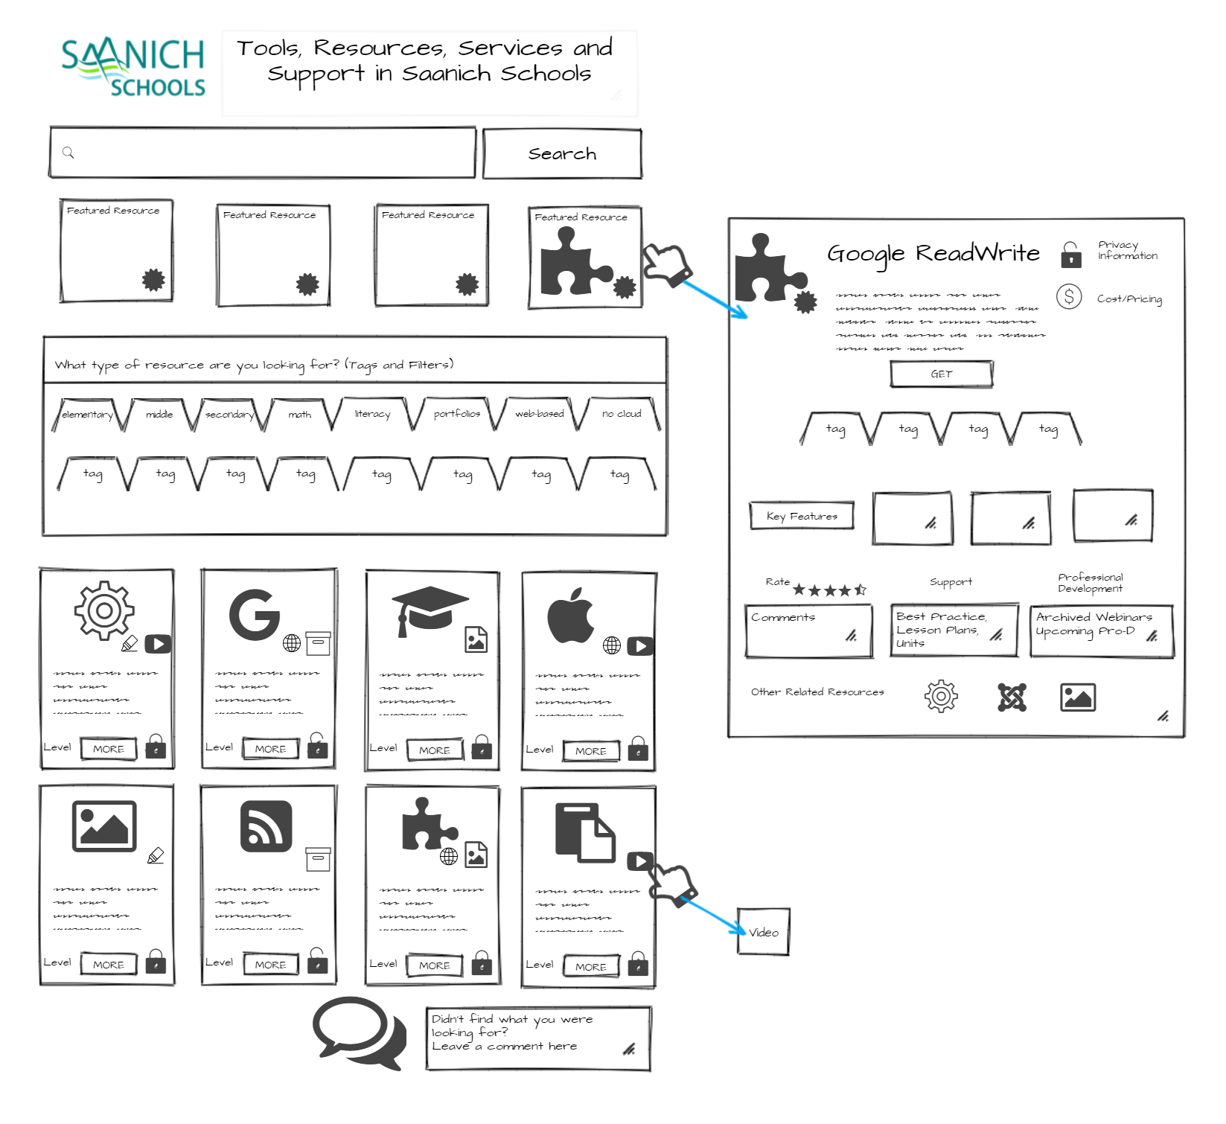
EdTech Working Group – The Yes Machine

Slide 18
EdTech Working Group – Ambassadors
Mini-meetings to help improve communication with schools
Time in staff meetings to report
Carry information to and from the central working group and school communities

Slide 19
Additionally…
Core French/French Immersion Refresh Plan (over and above ratios)
Support for in-district learning services device support (over and above ratios)
Renovating the ILC Training Lab to be used for the EA program including remote instruction
Greater support for the district staff and schools in providing insights through data
District-wide booking system for technology and shared spaces
Exploring our next platform for communicating student learning

Slide 20
Forward
The initial RefreshED plan was coupled directly to priorities in the strategic plan. As work is underway in the new strategic plan we want to ensure RefreshED addresses the current goals directly
Many new challenges, some related to the shifting landscape created by COVID and the effects it has had around the world
Supply chain issues and inflationary costs are significant
Phones and Copier Refresh Plans will carry cost pressures
We would like to present RefreshED/22 later this year

